Slide 1
Revision
Fill in the tables for the following rules
x | 1 | 2 | 3 | 4 | 5
y=2x+1
x | 1 | 2 | 3 | 4 | 5
y=3x+2
Notes:
hook

Slide 2

Story time
Mr Morgan takes his dog Thor for a walk everyday. On this particular day Mr Morgan left his house and walked for 2 minutes and then stopped. He stood still, because he felt he had forgotten something. He stood there for 1 minute before he realised that he left Thor at home! At this point He was 500m away from his house. He quickly went home getting there in 1 minute.
Complete the story time questions

Slide 3
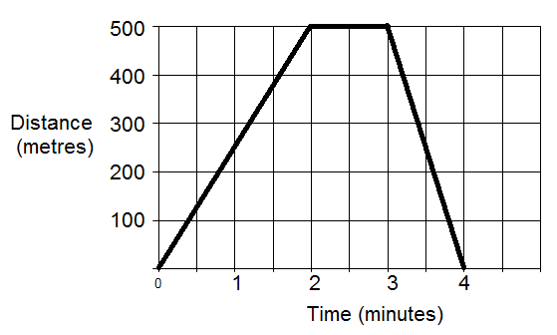
Answers
500m
500m
0m
Time | 0 | 2 | 3 | 4
Distance | 0 | 500 | 500 | 0

Slide 4
24
7
30
Date
Travel graphs
EQ – how do we draw travel graphs?
A travel graph plots or tracks the distance of a journey at different times.
Distance
time
5
Notes:
Lesson objective (EQ)

Slide 5
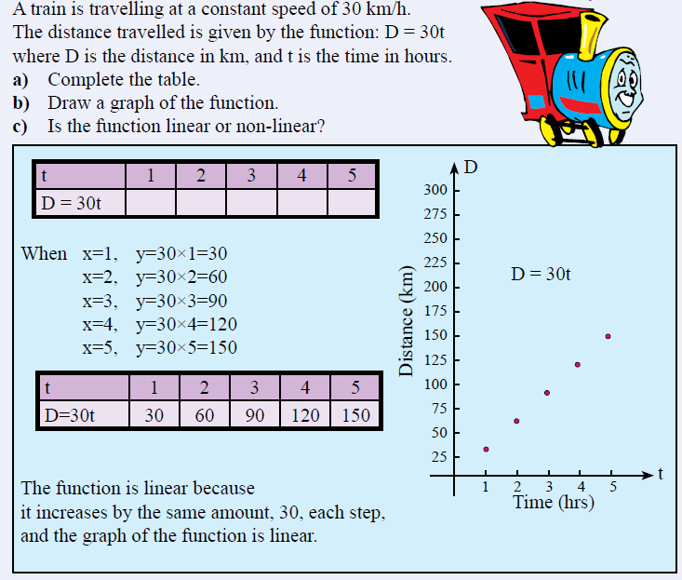
Check for understanding
Notes:
Check for understanding

Slide 6
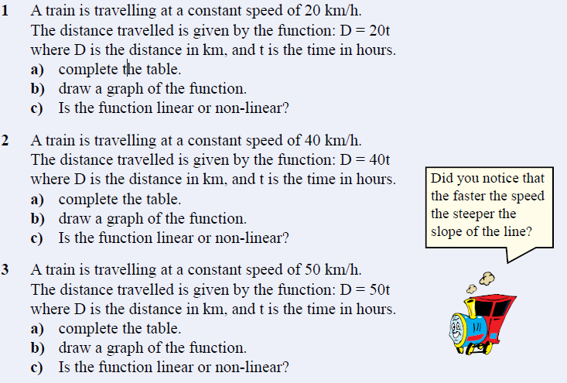
Practice
Notes:
Guided practice

Slide 7
Create your own Story
Create your own story like Mr Morgan and draw a travel graph for it.
Swap with your partner to see if they can draw the travel graph for your story
Notes:
Independent practice

Slide 8
Quick Quiz
What is a travel graph?
If part of a travel graph is flat, what does that mean?
Which axis has the time?
Bonus points:
What is the name of Mr Morgan’s dog?
Notes:
Closure

